Slide 1
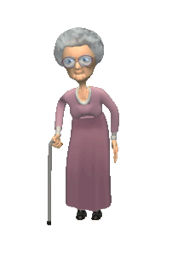
Living and Laughing
into
Your 90’s
A Healthier Approach
Presented by
Howard Manns
National Speaker, Author, Humorist
Notes:
Good morning and welcome to the VOICE Accord. This accord is all about change which is why I consider it to be one of the most important conferences. A change in how we provide care today and moving into the future. This is truly a celebration! A celebration of how far we’ve come and where we are headed.
My topic today is all about change. If you’re not someone who laughs and has a great sense of humor, I hope to provide you with a way to do just that.
Welcome! Honestly, how many of you, like me are shocked/surprised that you made it to this age?
I doubted making it to 18! I was a rebel without a brain! Rockstar, Hair to here!
WE ARE A HAPPY GENERATION!
How many of you have ever said about anything: “we’ll laugh at this someday!”
Well if you haven’t today is that day!
Let’s take a look at what happened..

Slide 2
What is
it we all
have in
common?
Living and
Laughing
into
Your 90’s

Slide 3
Aging
Living and
Laughing
into
Your 90’s

Slide 4
INSANITY
BURNOUT
STRESS
FRUSTRATION
Living and
Laughing
into
Your 90’s
Notes:
As an assisted living administrator for a number of buildings as well as a marketer/admissions, I know the industry and the challenges we face. There’s stress, anger, frustration, burnout and hearing some of the excuses for calling off a shift, there’s humor. Not until the next day or so.

Slide 5
LIFE BALANCE
LIFE!
BILLS
NEWS
CHILDREN
Living and
Laughing
into
Your 90’s
Notes:
And what about the daily living stresses! Everybody is going through something that nobody knows anything about.
Life is hard, Howard! And you’re going to stand there and tell me to laugh when I’m going through hell?
You know what else we all have in common?

Slide 6
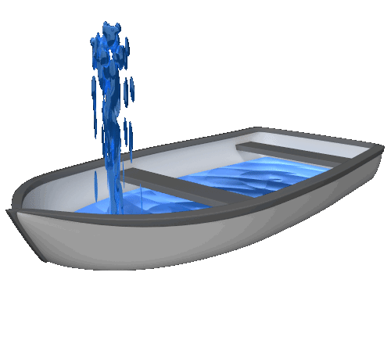
Challenges
Living and
Laughing
into
Your 90’s
Notes:
What else do we have in common? CHALLENGES. Life can throw you as curve ball at anytime. Can anyone relate to this? One day you’re going about your business, work, dinner, social time, Starbucks and then, all of a sudden…WHAM! Your life changes.
Why? Because LIFE has a sense of humor. And it’s going to test yours.
Let’s talk about some of those challenges. I wrote an addendum to this presentation recently.

Slide 7
Challenges
Living and
Laughing
into
Your 90’s
Notes:
You may not be able to notice because of my suitcoat but I’m missing a kidney.
Nine weeks ago this past Monday…

Slide 8
Laugh more
In this
crazy
world???
Living and
Laughing
into
Your 90’s
Notes:
You’re going to show us how to laugh in this crazy world?
Not really…I’m going to show you how to see crazy humor in this laughable world.
This is one life…laughter is just one choice.
I’m going to show you why it should be your choice. At least 3 times a day.

Slide 9
The Art & Science of
Humor &
Laughter
Living and
Laughing
into
Your 90’s

Slide 10
The Science of
Humor &
Laughter
Living and
Laughing
into
Your 90’s

Slide 11
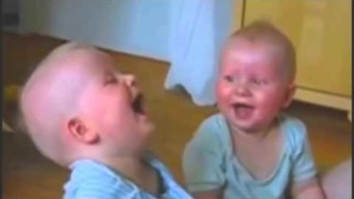
Living and
Laughing
into
Your 90’s

Slide 12
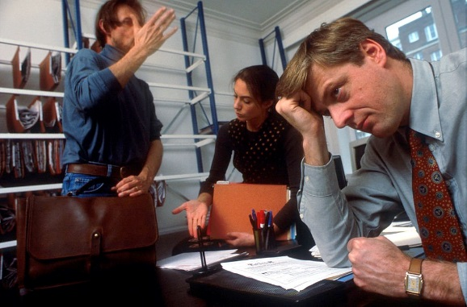
Living and
Laughing
into
Your 90’s

Slide 13
Some thoughts and statistics on HUMOR:
The average pre-schooler laughs or smiles 400 times per day. (drops to 15 times by age 35)
People smile only 35% as much as they think they do.
People with humor are:
more creative
more productive
better decision-makers
People with humor get along better with others.
Living and
Laughing
into
Your 90’s
Notes:
How many of you feel you have a good sense of humor? Great sense of humor?
Who knows someone who thinks they’re funny?
Let’s look at some statistics on humor…
35% Do you know anyone who is scary when they smile? (T-Story)
Boomers with humor are still creating businesses, not done?
They’ll expire long before they retire.

Slide 14
Have you ever seen a miserable
healthy person?
Living and
Laughing
into
Your 90’s
Notes:
Let’s go back…wiffle ball?
Get off the grass!
Healthy/miserable? You know why?....

Slide 15
The Healing Power of
Laughter
Living and
Laughing
into
Your 90’s

Slide 16
The Immune System vs. The Amuse System
Stress hormones suppress the immune system/raise BP
Laughter, natural killer cells increase destroying tumors/viruses
Laugh 100 Times = 10min Rowing/15min Exercise Bike
Laughter works out…
diaphragm, abdominal, respiratory
facial, leg and back muscles
Dissolves emotions: Laugh negative emotions away
Changes your “state”
Living and
Laughing
into
Your 90’s
Notes:
Stronger than drugs… Norman Cousins (30 Years ago)
Healing thought: Conscious mind: 1 thought/time
Laugh and you can’t think of bad

Slide 17
LIFE
Living and
Laughing
into
Your 90’s
Notes:
Travis Quote:
"No man can walk through life without things happening to him."— Ragnar Lothbrok, Brother’s War.

Slide 18
CHOICE
Living and
Laughing
into
Your 90’s
Notes:
There are going to be problems, emotional crises, and mmore.

Slide 19
Don’t Put Up a Tent!
Living and
Laughing
into
Your 90’s
Notes:
Worse, Don’t build a house there
My Story of Kidney

Slide 20
There’s
always
a reason
to smile!
Living and
Laughing
into
Your 90’s
Notes:
You just have to look a bit harder….sometimes starting with being grateful (life, children, grandchildren, the sun, rain).
Perspective: Negative = negative.
Today’s generation.
I’m in LTC! What about tattoos? Winnie v Smoky
Tomorrow’s Generation: LK Story

Slide 21
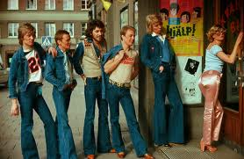
Explaining bell bottoms to
our grandchildren
Living and
Laughing
into
Your 90’s
Notes:
Has anyone had to do this yet?
We’re strong…or in Keith Richards (Stones), fermented!
Playboy Best of dead/live
OK, I can explain to my grand kids the bell bottoms

Slide 22
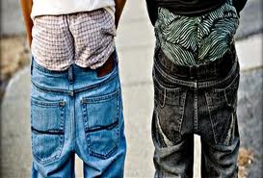
Can you imagine this conversation
…with their
Grandchildren?
Living and
Laughing
into
Your 90’s
Notes:
Can you imagine this conversation?
If 60 is the new 40…then 25 is the new 5 – makes sense, right?

Slide 23
It’s a Laughable
Life
Living and
Laughing
into
Your 90’s
Notes:
Travis Quote

Slide 24
Things that affect your joy…
Caring too much about what other people say.
Being scared to do things.
Not quitting a terrible job.
Not stopping enough to appreciate the current moment.
Being a wallflower.
Never taking a big risk.
Never performing in front of others.
Living and
Laughing
into
Your 90’s

Slide 25
Too Old
to Laugh?
Living and
Laughing
into
Your 90’s
Notes:
Travis Quote

Slide 26
Living and
Laughing
into
Your 90’s
Notes:
Travis Quote

Slide 27
Times have changed…
Living and
Laughing
into
Your 90’s
Notes:
Travis Quote

Slide 28
This crazy
Generation!
Lollapolooza 2014
Living and
Laughing
into
Your 90’s
Notes:
Today’s youth are much smarter than us
But we made it too easy
Tire Valves Playground, concrete
I still don’t understand braille ATM in the drive through
This generation: They’re wild!

Slide 29
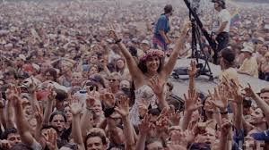
Why can’t they be more like we were?
Woodstock 1969
Living and
Laughing
into
Your 90’s
Notes:
Smile! You’re still here for a reason!
We became strong!
DEFEND OUR CRAZINESS…

Slide 30
iPhone
Living and
Laughing
into
Your 90’s
Notes:
They have perks…

Slide 31
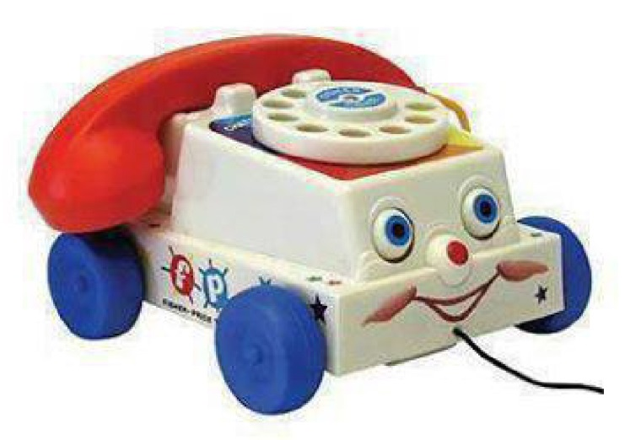
eyePhone
Living and
Laughing
into
Your 90’s
Notes:
…so did we

Slide 32
Five ways to
put more humor into your life!
Living and
Laughing
into
Your 90’s
Notes:
What I want you to take away from today is that it’s never too late…

Slide 33
#1
Figure out what makes you laugh and do it more often!
Read Good Books
Watch Funny Shows/Comedians
Just do it.
Escape from your daily routine!
Living and
Laughing
into
Your 90’s
Notes:
Go to Kennywood…alone!

Slide 34
#2
Start finding humor is everyday things!
Bumper sticker: Volunteers
Using a Bluetooth
Have fun with people
Change your voicemail message
Living and
Laughing
into
Your 90’s
Notes:
Better lovers? Victims
Don’t need a phone
Missing sock/laundramat

Slide 35
Talk to a
three-year old!
Living and
Laughing
into
Your 90’s

Slide 36
Talk to a
three-year old!

Slide 37
#3
Surround yourself with funny people!
People who make you feel good about yourself.
People that you make them feel good.
Become that person.
Living and
Laughing
into
Your 90’s

Slide 38
#4
Develop your own sense of humor.
Brand yourself.
Look at life through “your” color classes.
See humor in normally frustrating situations.
Living and
Laughing
into
Your 90’s
Notes:
Marjuauna is legal? What fun will that be?
Humor can get you in trouble…real story

Slide 39
When
humor is a
bad idea?
Living and
Laughing
into
Your 90’s
Notes:
Police Story

Slide 40
#5
Quit taking yourself so seriously.
Laugh at yourself. Write a book, song, play, etc.
Learn to play an instrument.
Start a new career. Yes, NOW.
Living and
Laughing
into
Your 90’s
Notes:
Write…at our age, we have the material
I wrote a book this year…I’m working on a new one: Success and Lunacy
Think I’m crazy? I hope so…

Slide 41
Putting it
all into
Perspective
Living and
Laughing
into
Your 90’s
Notes:
Who wore bicycle helmets?
Xbox, Playstation (Cardboard box, playstation) Burning box
We’re too serious today – SEVERE Weather!
Amber Alert – in our day, “he’ll come home” (dad)
Play favorites - counseling

Slide 42
One
Life to
Live
Living and
Laughing
into
Your 90’s

Slide 43
Living and Laughing
into
Your 90’s
A Healthier Approach
Presented by
Howard Manns
National Speaker, Author, Humorist
Notes:
Keep healthy through humor.
Smile more. Complain less.
Be EPIC. Be Healthy. Laugh!
Thank you….
Enjoy your afternoon!

